Slide 1
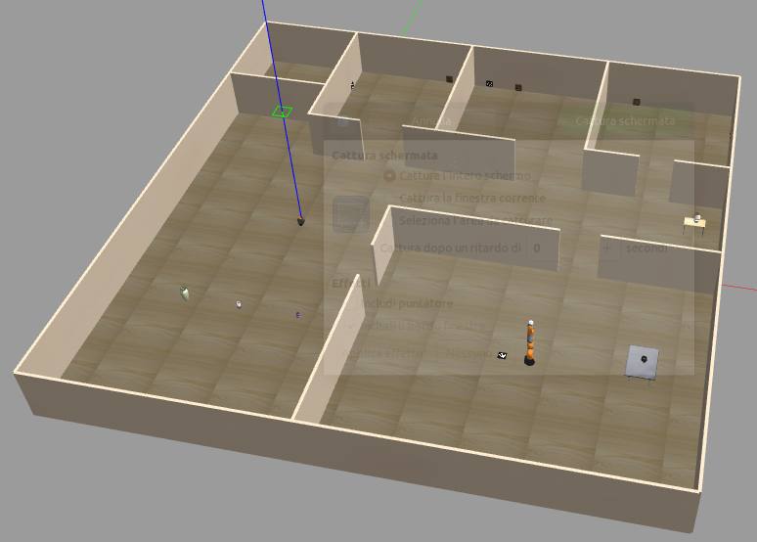
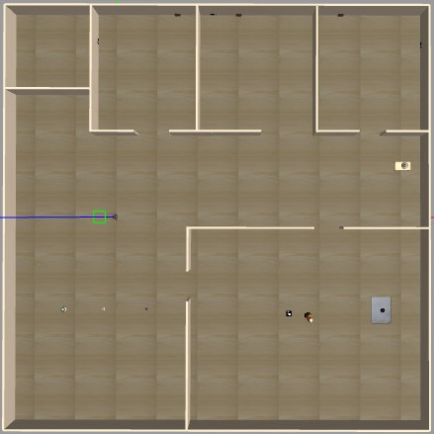
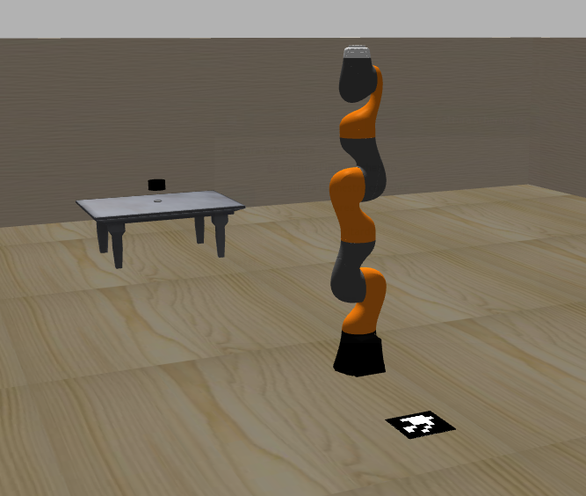

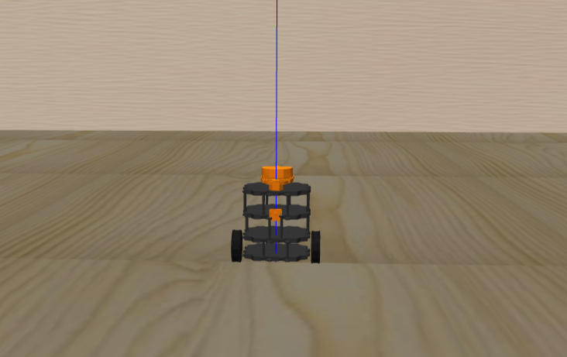
DIPARTIMENTO DI INGEGNERIA ELETTRICA E TECNOLOGIE DELL’INFORMAZIONE SCUOLA POLITECNICA E DELLE SCIENZE DI BASE Robotics Lab
Technical project
Michael Mirzaagha P38000094

Slide 2

Index
Introduction to the project
Presentation of the robots
Presentation of the environment
System Architecture
Conclusions
Video
2

Slide 3
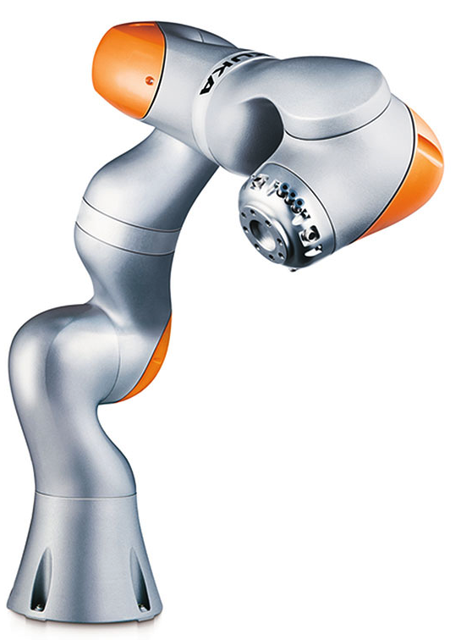
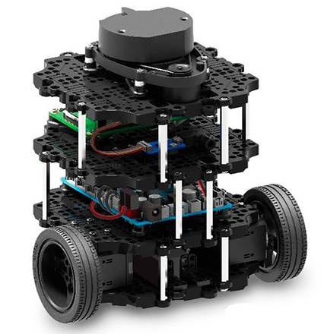

Introduction
An operator using the keyboard asks the turtlebot to take a particular tool (represented by an AR marker). The robot doesn‘t know where the object is placed, but it knows the coordinates of the center of the rooms. In every room, it looks for the AR Marker. After it finds the right marker, the turtlebot goes to the kuka. To take a tool, the turtlebot must just look at the ar marker contained in the room. The kuka, awakened by the turtlebot, simulates putting the object down, brings its end effector closer to the center of the marker present in its room.
ROBOTS
Turtlebot 3 burger
camera sensor in order to scan the markers attached on the walls;
lidar sensor to build a map of the environment so that it is able to navigate avoiding collisions with obstacles
Kuka IIWA 7
camera sensor to detect a marker placed on the ground
3

Slide 4
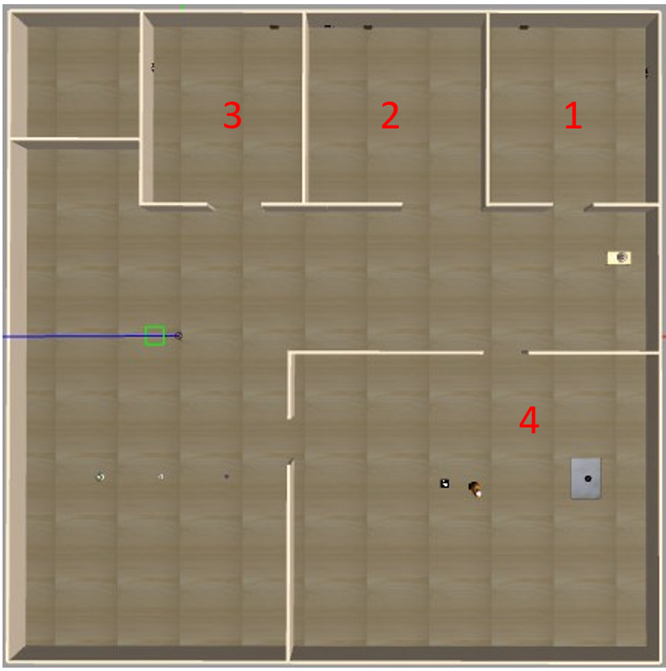
Environment
- The environment is composed of 4 rooms.
The first three rooms contain the AR markers and the associated tool: in the first room there is the hammer, in the second the toolbox and in the third the washer;
in each room, there is an AR marker that identifies the object;
in the last room there is the Kuka IIWA with the last AR Marker;
There is the turtlebot in the corridor;
There are other objects such as: lamps, vases, paintings and tables;
4

Slide 5
SYSTEM ARCHITECTURE
move_turtlebot
The user selects a particular tool from the keyboard: «h» : hammer; «t» : toolbox; «w» : washer, each placed in a different room.
It is a ROS action client node that contacts the move_base action server node to execute the motion that allows the turtlebot to search for the object for the various rooms. The robot doesn‘t know where the object is placed, but it knows the coordinates of the center of the rooms. Since the turtlebot navigates in an unknown environment, the robot must be able to map and localize itself on the map. Gmapping is a package that takes the laser scan data and odometry to build a 2D occupancy grid map. In order to perform the navigation, we need a static transformation between the lidar sensor and the base of the robot, it is realized by the transformation node of the tf pkg.
As soon as the move_base action server terminal status is equal to SUCCEEDED, the move_turtlebot node contacts the marker_turtlebot action server to identify the marker. To search the marker, the turtlebot rotates around the z axis, and to do this, it publishes the angular velocity on the topic turtlebot3_burger/cmd_vel. The robot rotates until either it finds the marker or if 14 seconds have elapsed.
If the marker is not in the room, the move_base server is called again by move_turtlebot and the latter sends the coordinates of the next room. When the turlebot finds the desired marker, it stops for 1 second (the move_turtlebot publishes the speed change on the topic turtlebot3_burger/cmd_vel) and, to reach the Kuka, it sends as goal to the move_bose node the coordinates of the room in which there is the kuka.
Once the turtlebot arrives in the room of the Kuka, it waits for 1 second and through the ROS service, it notifies to have found the right marker at Kuka.
5

Slide 6
marker_turtlebot
Marker_turtlebot is a ROS action server and its goal is to detect the markers. It is contacted by the move_turtlebot once the robot arrives into the room. It subscribes to the /turtlebot3_burger/camera/ image_raw topic and to take advantage of the aruco library of OpenCV, the ros image is converted in a cv pointer. It has as feedback the detected ID and a boolean value (which informs that at least one marker has been found), while the result is the ID. As soon as the desired market is found, the server sets the status as SUCCEEDED. If the desired marker isn’t found in14 seconds, the goal is deleted by the client.
move_kuka
The move_turtlebot communicates with the move_kuka through ROS Service, in fact, the latter assumes the role of ros service server.
Move_kuka node uses the move_group node of the kuka_iiwa_config package to realize the motion of the Kuka. During the search for the marker on the floor, the marker_kuka action server is called, in order to detect the marker. The kuka rotates on itself and as soon as it finds the marker it positions its camera above it, and it stops rotating either if the marker is found or if more than 30 s have passed. If the marker is found, the move_kuka sends a message to the ROS service move_turtlebot to notify if everything went right, otherwise, if the marker isn’t found, the return value of the callback will be false .
6

Slide 7
marker_kuka
Marker_kuka is a ROS action server and it takes care to individuate the desired marker. Its operations are similar to that of the marker_turtlebot, the main difference is that it returns, in addition to the marker ID, the coordinates of the center of the marker. It is called into question by the move_kuka when the kuka is looking for the marker. To detect the right marker, it subscribes to the /camera2/image_raw topic and in order to use the aruco library of OpenCV converts the ros image in a cv pointer. It subscribes also to the /camera2/camera_info topic to save the values of the intrinsic parameters and of the distortion coefficients. If the desired marker is found, the server sets the goal as SUCCEEDED instead if the marker has not been identified in 30 s, the goal is cancelled by the client.
7

Slide 8
To sum up (1)
The system is composed by 8 main nodes with 4 of them that came from external packages:
move_turtlebot: allows the user to choose the tool to take from the keyboard, takes care of assigning the positions the robot should reach and setting the turtlebot speed; it communicates with move_kuka via ros service and with marker_turtlebot via action server.
move_kuka: takes care of controlling the movements of the kuka, allowing it both to turn on itself and to position its camera on the marker; it communicates with move_turtlebot via ros service and with marker_kuka via action server.
marker_turtlebot: allows to identify the various markers and check if the desired marker has been found;
marker_kuka: allows both to verify if the marker found is the desired one and to calculate its coordinates
8

Slide 9
To sum up (2)
Transformation: is useful to make a static transformation from the LIDAR coordinate frame to coordinates in the robot base frame (node from external package) ;
Gmapping: uses data from the /laser/scan topic and odometry in order to build a 2D occupancy grid map. This node allows to perform at the same time mapping and localization (SLAM) (node from external package);
move_base: is used to move a robot from its current position to the desired position. It is called by the action client move_turtlebot (node from external package);
move_group : it is the main part of Moveit and helps the Kuka make all the necessary movements to reach the maker. This node belongs to the kuka_iiwa_config package, created thanks to the MoveIt Setup Assistant. (node from external package);
9

Slide 10
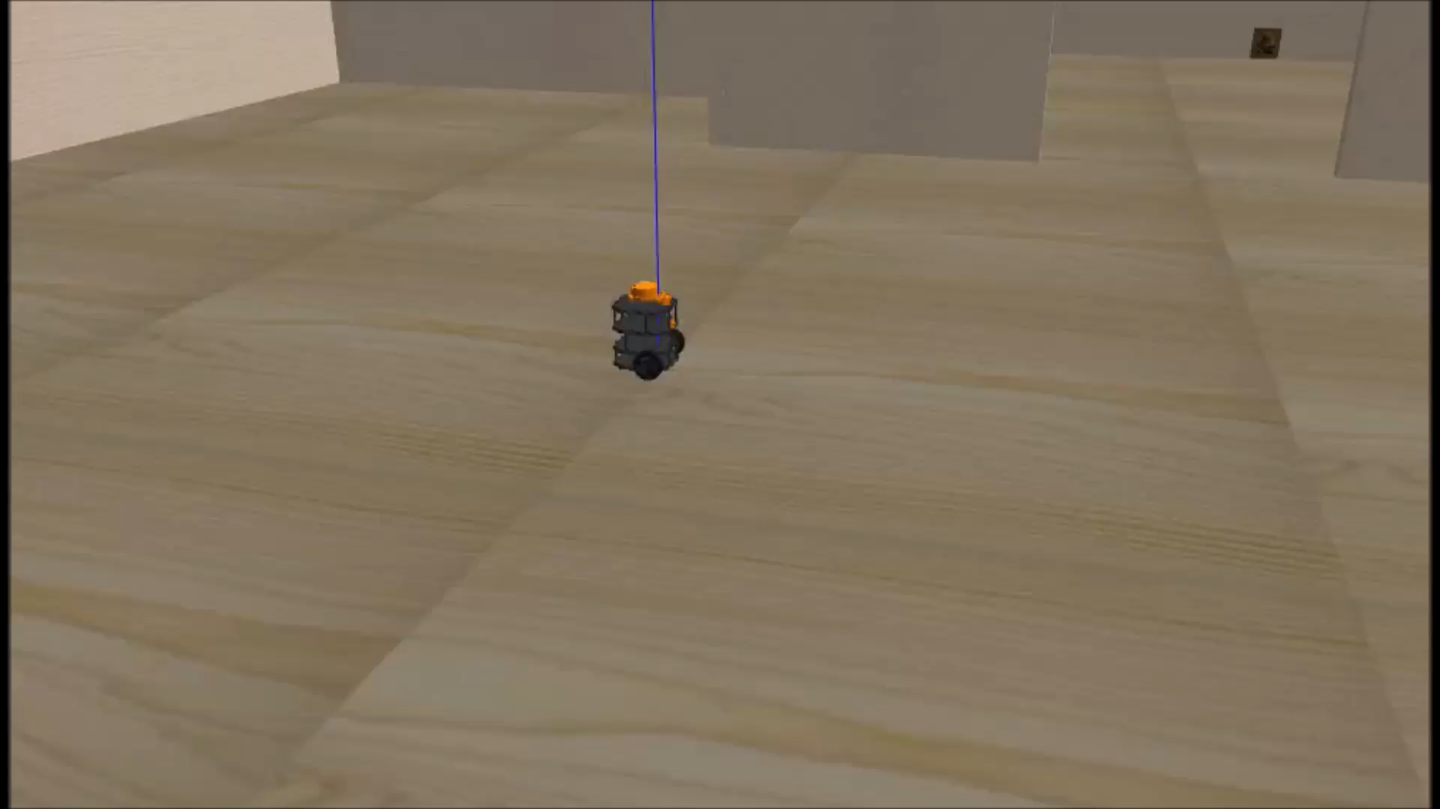
Video
10

